Slide 1
Battle Tanks ECE 540 Final Project
By
Mark Chernishoff, Hai Dang, Aditya Pawar

Slide 2
Gameplay
Purpose: To destroy opposing tank
Rules: If opposing tank destroyed 3 times, that players wins
I/O
Keyboard is used to control tanks and firing
Sound generated for each screen
All maps and icons are output to VGA screen

Slide 3
Block Diagram

Slide 4
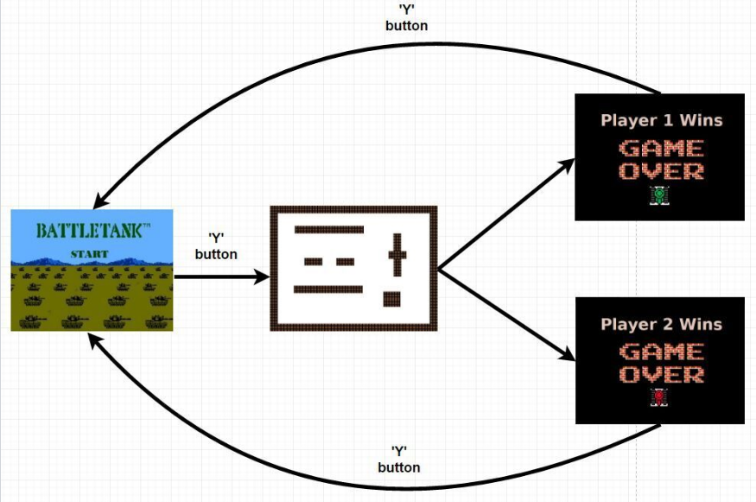
Game Screen Switch Logic

Slide 5
Responsibilities
Game_screen, switch.v – Mark Chernishoff
Audio, keyboard – Hai Dang
Switch_interface, Icons – Aditya Pawar

